Slide 1
Scholarly Activity Report
Chicago Manual of Style (CMS) for Citations

Slide 2
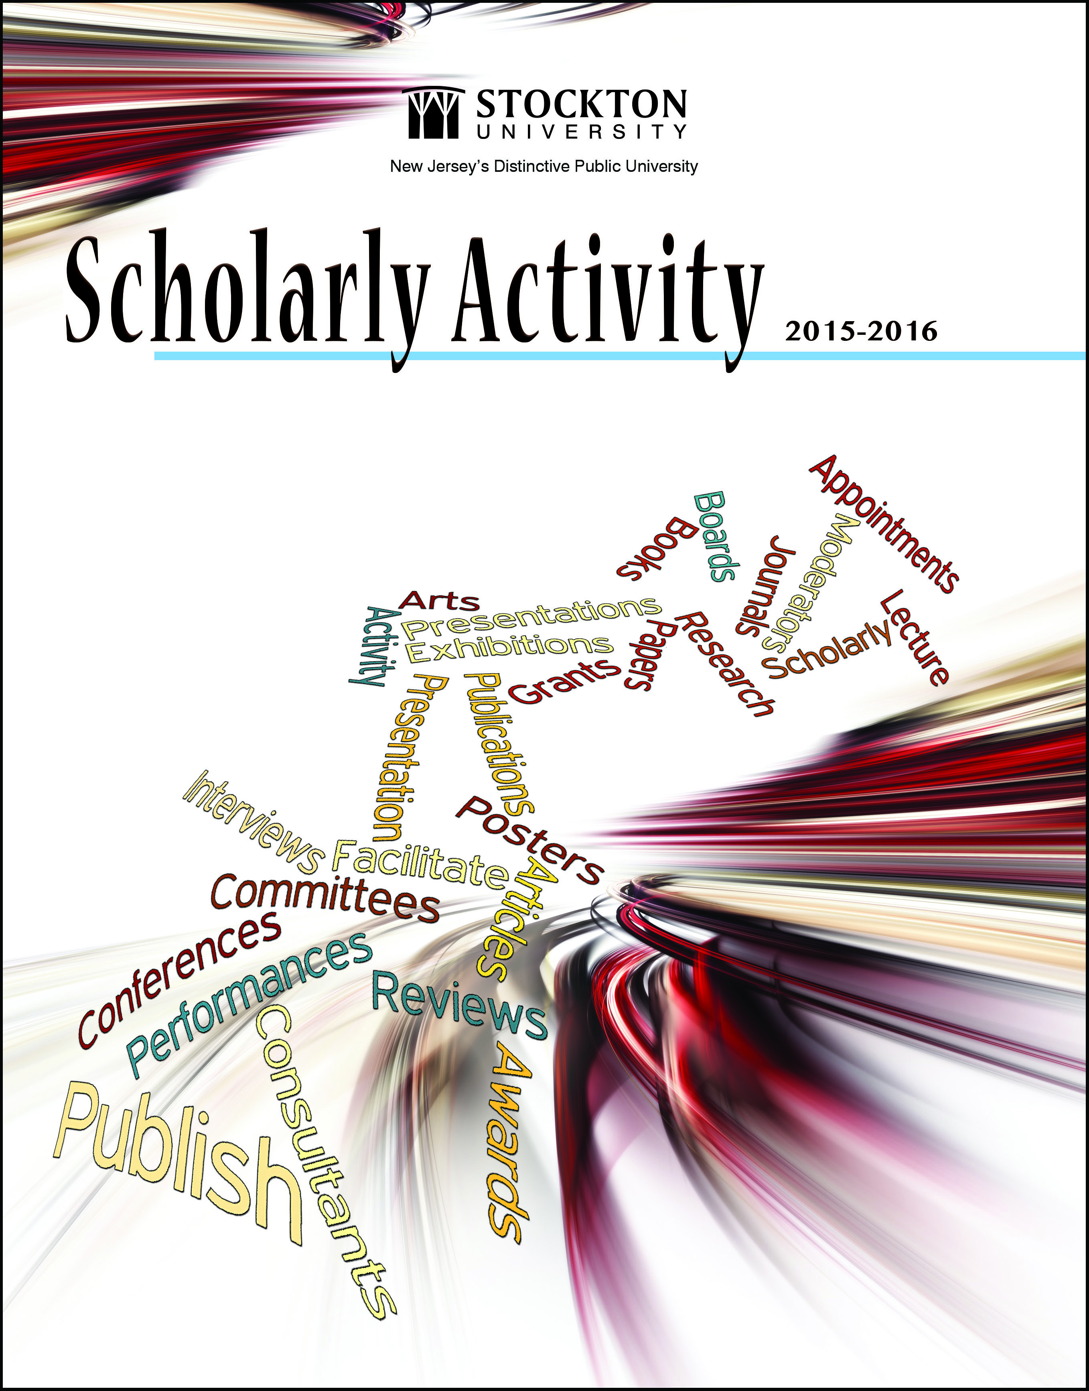
What is a citation?
A quotation from or reference to a book, paper or author, especially in scholarly work.

Slide 3
Things to know when submitting your School/Division’s citations:
Citations are for INDIVIDUAL achievements, not for office accomplishments;
External Sponsored Grant Awards are not included in this publication. They will be published in a separate book at the end of the year. The ORSP will pull that information from our database;
Accomplishments should be directly connected to Stockton University’s strategic themes;
Management Staff, Full Time Faculty, and PT/Adjunct Faculty activity should be submitted to the school/division liaison in the correct citation format, using Chicago Manual Style;
Stockton presentations/workshops are not eligible for entry in the book, unless the activity took place at an event hosted by an outside entity at a Stockton site.
External activities, for external events, should be reported when the participant had a role beyond attending or performing their daily activities.

Slide 4
What types of activity should be cited?
Books Published
Whole Books (author and/or editor); Chapters; Sections of a Book/Encyclopedia
Published Works
Article (in Newspaper, Journal, Magazine, Online Publication); Website; Review of Book; Poem; Essay; Memoir; Edited Published Works
Performances/Exhibitions
Media; Videos; Documentaries; Radio; TV; Podcast; Screening; Photos; Interviews
Presentations (no churches or Stockton internal events, i.e. Day of Scholarship)
Lectures; Seminars; Papers; Session; Panelist; Keynote; Facilitator; Symposium; Judge; Moderator; Reading
Boards
Commissions; Committee; Reviewer; Appointment; Consultant; Named Chair; Elected Member
Awards/Grants
Fellow; Patents; Who’s Who?
Professional Development (individuals, not departments – no webinars unless it is a conference that has gone virtual due to restrictions)
Conference or Workshop Attendance

Slide 5
What formatting style should be used?
The Chicago Manual of Style (CMS) – for Board Book Snapshots and Entries in the Annual Scholarly Activity Report

Slide 6
Books Published -
Book Author and/or Editor:
Doe, John. The Book. New York: Penguin, 2016.
Doe, John, and Bob Smith, eds. The Book. New York: Penguin, 2016.
Doe, John. The Book. Edited by Jane Doe. New York: Penguin, 2020.
Book with more than one author:
Doe, Jane, Bob Smith, and Tim Jones. The Book. New York: Penguin, 2016.
Section of Book:
Doe, Jane; “The Beginning.” In The Book, edited by John Smart, 14-20. New York: Penguin, 2016.
[Published proceedings (not in a named journal) also appear in this form.]

Slide 7
Published Works: Journal Articles, Magazine/Newspaper Publications, Book Reviews -
Journal Articles
Doe, John. “Americanized Comics.” Critical Inquiry 4, no. 2 (2016): 200-13.
Doe, John. “Americanized Comics.” Critical Inquiry 4, no. 2 (2016): 200-13. doi: 10.1086/ahr.113.3.752.
Doe, John. “Americanized Comics.” Critical Inquiry 4, no. 2 (2016): 200-13. http://www.jstor.org/stable/123344.
Magazine/Newspaper Publications
Smith, Debbie. “From Here to There.” Atlantic Monthly Magazine, July/August 2016, 14.
Jones, Mark. “The Five.” New York Times, October 5, 2016. http//www.nytimes.com.
Book Review
Smith, Bob. Review of Song Bird, by Jane Doe. American Review 113 (May 2016): 400-14. doe:10.1085/ahr.113.2.449.
Notes:
Published proceedings in a named journal also appear in this form.
Just include the number of the first page when citing in Magazines and Newspapers.
The Full URL should be used for magazine/newspaper articles which appear online.

Slide 8
Conference Presentations, Performances and Exhibitions -
Conference Presentations:
Brown, Ginnie, John Doe, and Mary Smith. “Time to Stand.” Paper presented at the Annual Meeting of American Psychologists, Philadelphia, PA, March 2016.
Doe, John. “Time for Peace.” Poster presented at the Annual Meeting of American Psychologists, Philadelphia, PA, March 2016.
Performances and Exhibitions:
Clark, Eric. Atlantic City Orchestra. “Beethoven's Triumph.“ Conducted at Borgata Hotel and Casino, Atlantic City, NJ, August 2015.
Lee, Amy. “The Road to Fall.” Exhibited at the Chin Museum of Art, New York, NY. September 2016.
“How to be a college student.” Interview with The Press of Atlantic City, July 1, 2018.
Note:
The preposition part of the sentence should be placed mid-citation.
i.e “present at” or “conductor at”

Slide 9
Boards, Awards and Grants, & Professional Development -
Boards
Chair. Smith, John. The American Society of Artists. Marriot East, Dallas, TX. March 5-8, 2016.
Elected President. Smith, David. AtlantiCare, AtlantiCare Research Committee. 2016-2018.
Consultant. Jones, Peggy. Eastern Accreditation in Education. 2016.
Grants and Awards
Smith, John. Atlantic County Block Grant, Atlantic County Government. “A Time to Shine.” 2016.
Brown, Peg. Scholar Award in Excellence. “Change is Coming.” Annual Artist Conference, Absecon, NJ. March 8, 2016.
Professional Development
Doe, Jane. Attended the Annual Meeting of the American Psychology-Law Society, Philadelphia, PA, September 2016.

Slide 10
References
Citations are due quarterly according to the emailed schedule of due dates.
The Scholarly Activity Book runs from July through June annually.
Any items submitted, but deemed ineligible, will not be printed in the book.
Questions regarding due dates and/or formatting should be posed to Ronnie Maiorino. Please allow 1-2 business days for a response.

