Slide 1
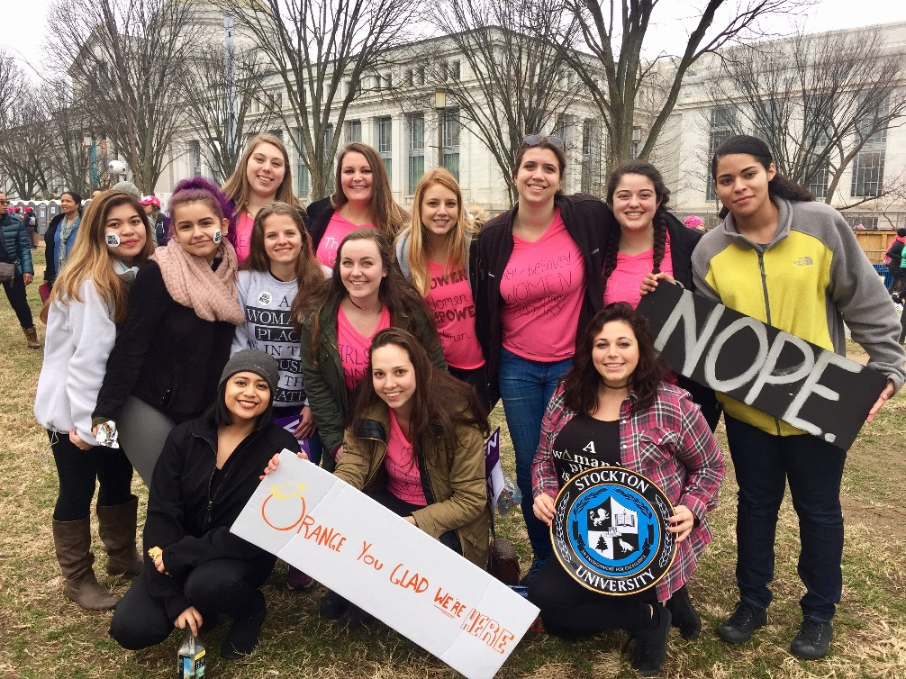
“How To” Series
A set of workshops where students will develop the skills needed for effective political activism
How to Organize
in Politics

Slide 2
Groups in Politics
Individuals can join groups to amplify their actions and demonstrate support for their position
“In democratic countries knowledge of how to combine is the mother of all other forms of knowledge; on its progress depends that of all the others.” - Alexis de Tocqueville
Social Movements
Loose coalition of groups with common goals oriented toward mass action
Interest Groups
Formal organizations that use a wider variety of tactics
Collective action from these different groups occurs when individuals coalesce around a shared goal or idea and are willing to work together toward making that goal a reality

Slide 3
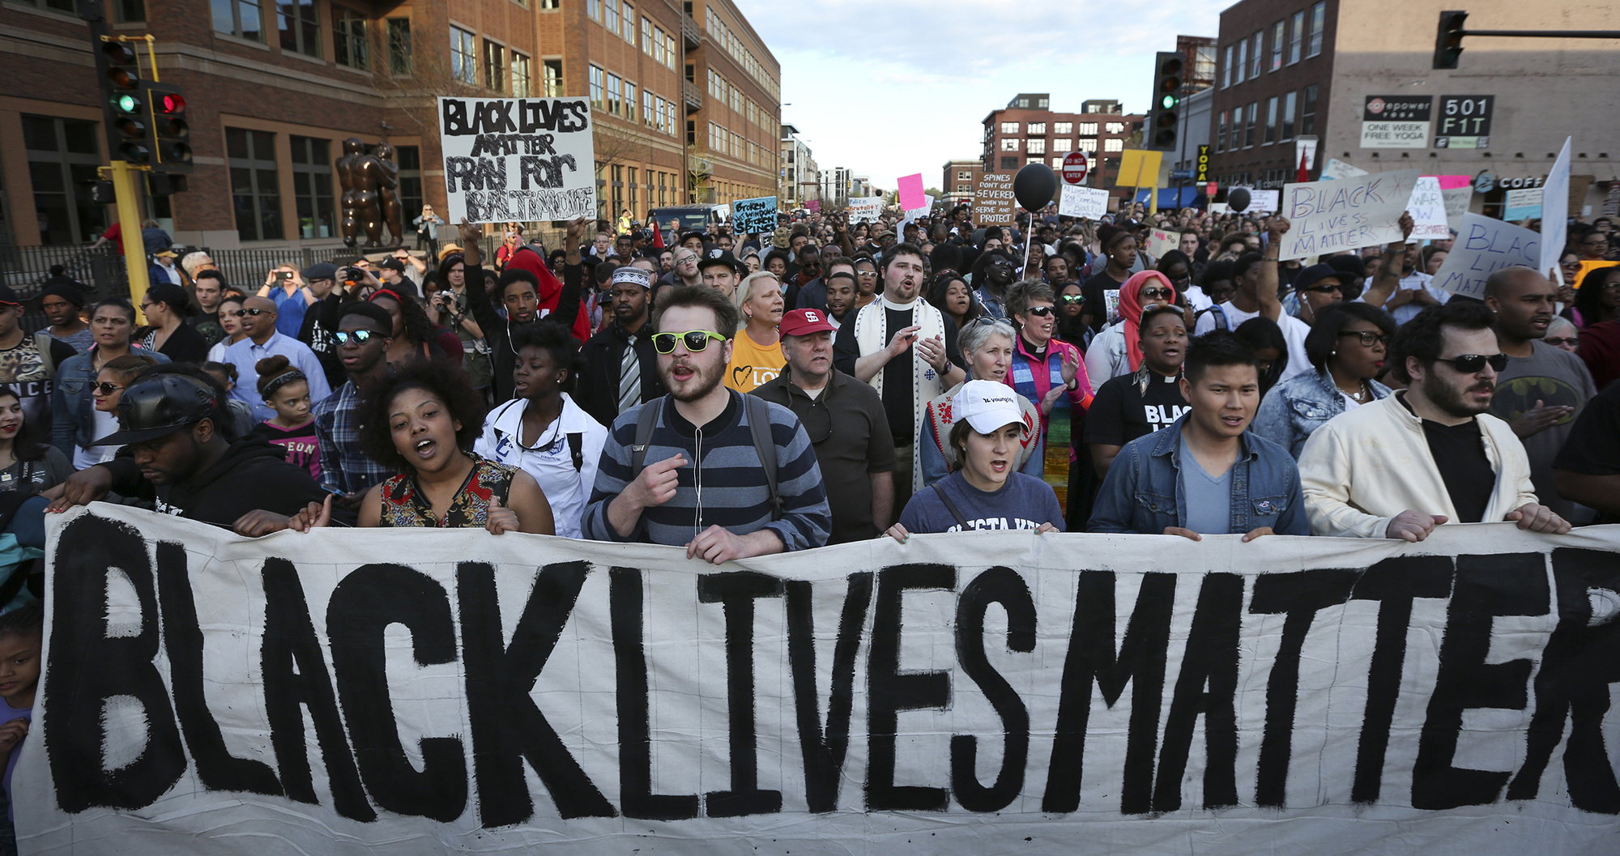
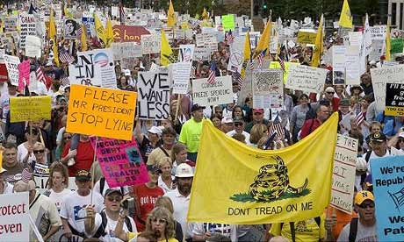






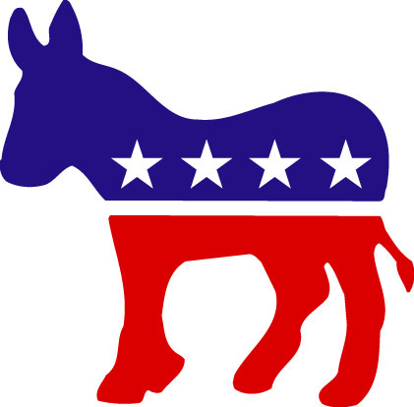
Groups in Politics
Groups
Political Parties
Boards

Slide 4


Joining groups!
Groups
Specializing
Even if you feel strongly about multiple issues, you should choose an issue specialty
This makes you more effective and allows you to get more involved on your priority issue
Choosing your level of commitment
Leader? Member? Supporter?
Directory
VoteSmart.org

Slide 5
Finding your issue and your group
Groups
National groups
In-person involvement opportunities are likely to be more limited
National groups can be a good avenue if you want to contribute, but do not have a lot of time to dedicate
Might have state or local chapters
National groups play an important role, but we’ll focus more on local collective action
You can make the most impact on local groups
You can work your way up from these local groups to being involved at higher levels
State and local groups
Get in touch with the groups you find in your area
Go to their next event or meeting and see what they’re all about

Slide 6

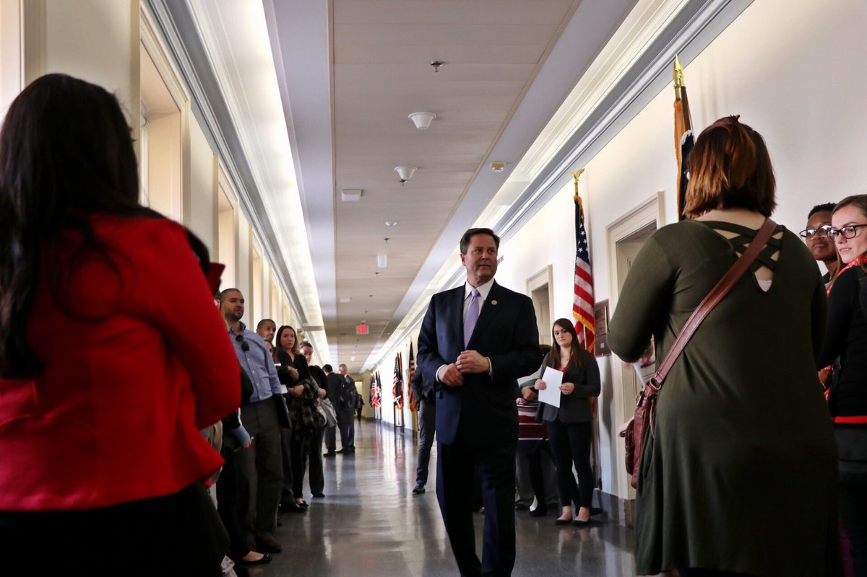

What it means to be a group member
Groups
Attend town halls or other events with elected officials
Visit elected officials’ offices
Organize events
Letter writing campaigns to elected officials
Publicize group’s position
Attend other groups’ events, build a coalition of support
Research policy developments related to the group’s goal
Share information about your issue
Stay informed about the group’s plans
Join coordinated activities that the group is planning

Slide 7
Another group to consider: parties!
Political Parties
Political parties are the most lasting and effective group organizations in American politics
Parties are loose coalitions that care about policy across a large number of issues
U.S. has a two-party system, with many of the rules of our elections reinforcing that system
Democrats and Republicans hold control over nearly all elected offices
Parties have evolved significantly over time
Parties respond to the changing demands of rank-and-file members and absorb the issues that third parties focus on
People can join parties as rank-and-file members and work from within to shape their positions and priorities
Parties are effective conduits for policy change because so much of our system is driven by the political parties

Slide 8
Joining the party!
Political Parties
Which party is right for you?
Read their platforms, even if you think you know which party you align with
Identify points where you disagree with the party
These areas of disagreement are where you can direct your efforts to reshape the party positions
Republican Party Platform
Democratic Party Platform

Slide 9

What it means to be a party member
Political Parties
Find the state or local party organization
Plan to attend their next meeting
See how others are involved
Get involved as a volunteer
Express your views on how the party should change
Focus on one issue at a time
Make an argument for why the party should change on that issue
Network with other party members and convince them about your change – build a group of supporters within the party
Find the state party information from the national party page
Find the local party information from the state party page
Or….

Slide 10
Joining Boards!
Boards
You can serve on local-level boards or commissions that make decisions on area issues
Boards at the local-level need citizen involvement to work effectively
Find out what is available
Visit your local government website, which lists all boards and commissions and their existing vacancies
Attend a meeting of the board you are interested in joining
Apply
Citizen Leadership Form from local government website
Tips to make it onto the board
Reach out to people currently on the board
Regularly attend meetings
Introduce yourself to the official in charge of appointing board members

Slide 11
Group? Party? Board?
Parties if you would like to be active on numerous issues
Groups if you are more interested in a specific issue
Boards if you’ve got time and energy to devote to a bigger commitment

