Slide 1
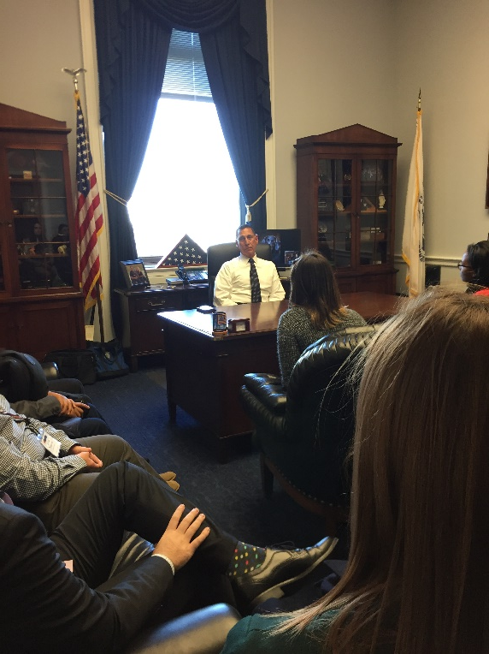

“How To” Series
A set of workshops where students will develop the skills needed for effective political activism
How to Contact
Congress

Slide 2
What political issues do you care most about?
Brainstorming
What issues do you want to try to shape?

Slide 3
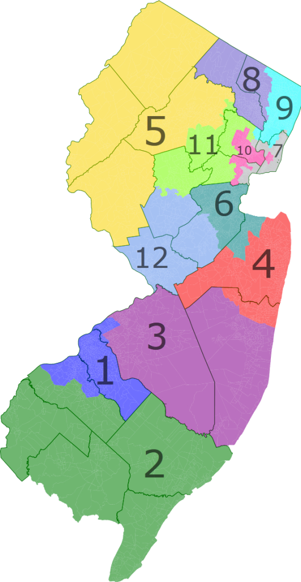
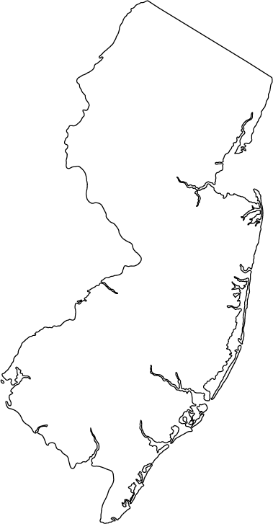
Research
Knowing who to contact
Two Senators that represent entire state
One Representative that serves the congressional district you live in
Your influence is the strongest with these officials who directly represent you
Identifying your Members of Congress
Write down the names and office phone numbers
of your two Senators and your Representative
Note Washington D.C. and nearby district office
phone numbers
Follow them on social media or sign up for their e-newsletters to
stay up to date!

Slide 4
Research
Knowing the issue
Specializing
Even if you feel strongly about multiple issues that Congress is debating, you should choose an issue specialty
You should think strategically about which issues to prioritize and when to reach out to your Senators and Representatives about them
Choosing your issues
Is Congress responsible for making policy for this issue?
What has Congress been doing for this issue lately?
Congress.gov
Search the issue you are interested in
Related bills will be returned
Use filters on the left side of the search results
What if Congress isn’t working on it?

Slide 5
Legislative Process…in 1 slide!
Legislation is Introduced
--Individual Members of Congress can write bills
--Bills introduced to the chamber
All bills are then referred to Committee Committees take a closer look at bills
--Hold hearings with experts
--Make changes to bills by offering amendments
Committee votes on bills
Committee votes on the bills that they have considered
--If bill passes in Committee, it moves to the whole chamber
Bills that were approved by Committee are debated on the chamber floor
Individual Members of Congress can:
--Make speeches
--Try to make changes to bills by offering amendments
Chamber votes on bills
Most bills in Congress die in the Committee stage
The Committee doesn’t take a closer look and the Committee never votes on them

Slide 6
Legislative Process and Your Contacts to Congress
Legislation is Introduced
All bills are then referred to Committee
Committee votes on bills
Bills that were approved by Committee are debated on the chamber floor
Chamber votes
on bills
Ask your member of Congress to offer amendments to a bill
Ask your member of Congress to make a public statement about a bill in a speech
Ask your member of Congress to introduce a bill
Ask your member of Congress to vote a certain way on a bill in Committee
Ask your member of Congress to co-sponsor a bill
Ask your member of Congress to vote a certain way on a bill in the chamber vote
Ask your member to offer amendments to a bill

Slide 7
Research
Knowing the issue
Visit your Members’ websites and look for
“Positions” or “Priorities”
You can search House and Senate roll-call
votes to see how your Representative and
Senators vote on each bill on the chamber floor
Knowing your Senators’ and Representative’s position on the issue
Their stated position on the issue might shape the message you want to send
How to find your Senators’ and Representative’s position
Look at their websites or their voting records on the issue
Look at interest group ratings, where possible
Interest Group Database
Select issue area from the drop-down menu
Results show related interest groups and information
about their ratings for current members of Congress

Slide 8
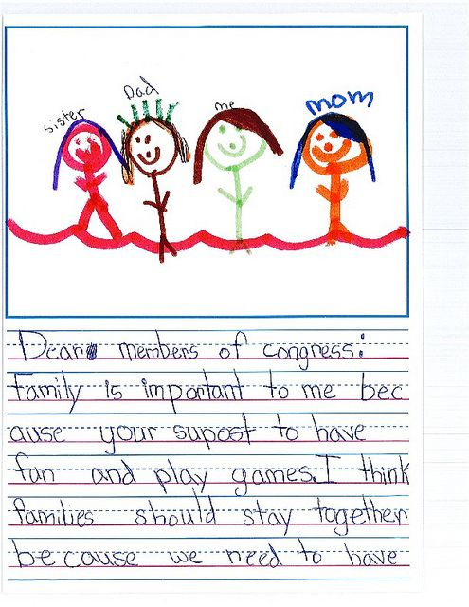
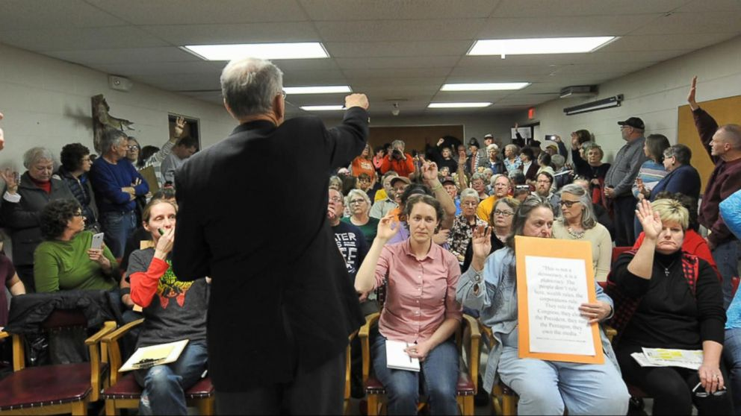


Effective Contacts
How you should reach out
Social Media
Letters
Emails
Faxes
Phone calls
In-person events (town hall meetings)

Slide 9
Effective Contacts
What you should say
Identify yourself as a constituent
Offices need to confirm that you live in the district
Be specific
Your contact needs to have a clear ask – be direct about what action you are asking the Representative or Senator to take
Do you want your member of Congress to vote for X bill? To vote against X bill? To co-sponsor X bill?
Remember, your ask should be connected to the part of the legislative process that the bill is in!
If you are interested in a specific bill, refer to it by name and bill number
You can find that on Congress.gov
One issue at a time

Slide 10
Effective Contacts
What you should say
The more personal, the better
Personal stories from constituents about how a policy idea will impact them directly stand out to congressional offices
Members of Congress appreciate stories that humanize the issue, as these stories can reveal the real-life consequences of proposals that Congress is considering
Be brief and to the point
Be respectful

Slide 11
Effective Contacts
Basic script to follow for effective contacts with Congress
Identify yourself as a constituent – I’m Talon the Osprey from Galloway, NJ, zip code 08205.
State your specific reason for calling or writing – I’m concerned about X policy, and bill XYZ in particular. I ask that the Representative/Senator [support/oppose/co-sponsor] bill XYZ.
Share your personal connection to the policy and why you think your Representative/Senator should [support/oppose/co-sponsor] the bill – I feel strongly about bill XYZ; if it passes, these are the consequences that I’d likely experience…
Close by asking again for the specific action you’d like the Representative/Senator to take
Ask for a response from the office that identifies the Representative’s/Senator’s position on X policy, and bill XYZ in particular

Slide 12
If you disagree with your Representative or Senators should you still contact them? YES
If you agree with your Representative or Senators should you still contact them? YES
How often should you reach out about an issue? This is a balancing act. You should develop a habit of reaching out to your members of Congress, but vary the issues that you reach out about.

Slide 13
How do you plan to reach out?
Brainstorming
What will your message and personal story be?
What research do you want to do before you reach out to Congress?

Slide 14
Join us for the next workshop
in our “How To” Series
How to Organize in Politics
TRLC (Multi-Purpose Room)
Tuesday April 11 11am-12pm & 6pm-7pm
Wednesday April 12 11am-12pm

