Slide 1
File Construction Workshop Year 5 (Tenure) Original content: CTLD 2020 Updates: Kerri Sowers Fall 2024

Slide 2
Today’s Session
Important Resources
Year 5 (Tenure) File Construction
Questions

Slide 3
Important Resources
Locally Negotiated Agreements
Faculty Evaluation Procedure MOA
Faculty Evaluation Policy (University Standards – section 6.00 and 10.0)
Program Standards
School Standards
Online Course MOA
Personnel Actions Calendar
Summary Due Dates

Slide 4
File Construction Approach
YR 5 file is due by 5pm on February 4th
Review MOA, Policy, & Standards
Ask mentor/colleagues for samples & advice
Consider your audience (PRC, Dean, FRC, Provost, President)
Gather artifacts/evidence of excellence
Engage in thoughtful self-reflection
Utilize FAWN

Slide 5
Purpose of Decision File
Procedure required by MOA
Self-reflect on performance
Receive tenure and promotion
Receive feedback from PRC, Dean, FRC, Provost, and President

Slide 6
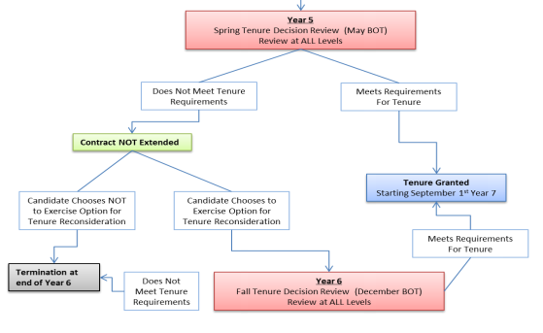
Stockton University MoA: Procedure for the Evaluation of Faculty & Library Faculty (2015)

Slide 7
Required Fifth Year File Content
Background Materials
File cover page & position description/responsibilities (School uploads)
Updated Curriculum Vitae (CV)
Self-Evaluation
Executive Summary
Narrative - reflect on ACHIEVEMENT of standards
Consider potential need for decoupling of tenure & promotion in this file (Covid or other reason)

Slide 8
Self-Evaluation
Executive summary
1-2 page overall summary
Narrative
Teaching section
Service section
Scholarship section

Slide 9
Required Fifth Year File Content
Teaching Portfolio
Representative syllabi
Peer observation(s) - 2 per year
10 total, except for 2019/2020 – Covid MOA (must cite)
SIPET trained and/or tenured faculty
Hybrid/Online course if they are part of your normal load
G course observation required
IDEA/small class instrument
Optional for spring 2020 – Covid MOA (must cite)
Precepting survey
Optional additional materials (sample assignments, lectures, rubrics, class feedback, etc.)
Provide evidence and reflect about how you have met the standards for tenure and promotion

Slide 10
Required Fifth Year File Content
Scholarship Evidence
Samples of scholarly or creative work(s)
Evidence of reviews, grants, or awards
External Review (for early promotion to Associate Professor)
Provide evidence and reflect about how you have met the standards for tenure and promotion
Service Evidence
Evidence of awards
Letters that document impact of service (external and internal)
Notice of committee appointments
Task force/committee reports, meeting notes, other evidence that documents service contributions
Provide evidence and reflect about how you have met the standards for tenure and promotion

Slide 11
Mistakes to Avoid
Missing or inaccurate CV information
Not considering the readers when writing (consider clarity, brevity, & specificity)
Failing to reference the standards for excellence in teaching, service and scholarship (& promotion)
Failing to provide evidence
Not connecting your evidence to your self-evaluation

Slide 12
More Mistakes to Avoid
Teaching philosophy not supported by evidence (or missing)
No examples from IDEAs
Overreliance on IDEA scores
Lack of reflection/examination of trends (IDEA & other assessments)
Not addressing feedback from previous file letters
Not addressing precepting as teaching
Blaming students for issues
Failing to provide referenced document (or not referencing document used as evidence)

Slide 13
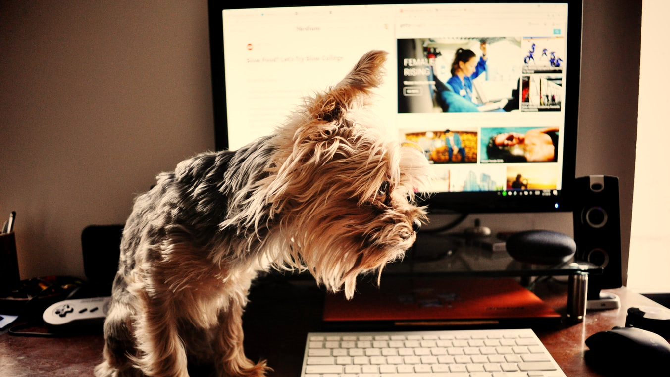
Uploading File Content
Login Instructions
Upload = Slow process

Slide 14
Next Step: YR 5 (Tenure) Decision Year Program Review Committee (PRC) Vote
PRC consists of either all or most of the tenured members of your program
Minimum of 3 tenured faculty members
Large programs (>10 tenured faculty members) the PRC will consist of at least 7 members, elected by simple majority
Decision year – PRC vote
Separate vote for tenure and for promotion
The PRC can only consider the information in the file when providing feedback or decisions
You are allowed to write rebuttal letters at each stage of the process (PRC, Dean, etc.)
You have 3 days (letters are usually due by 2 PM)
Reach out to the Union and CTLD for assistance

Slide 15
Next Step: Dean Review
Dean will review the PRC letter and your file and make a recommendation separately for tenure and for promotion
You have 3 days to submit a rebuttal letter

Slide 16
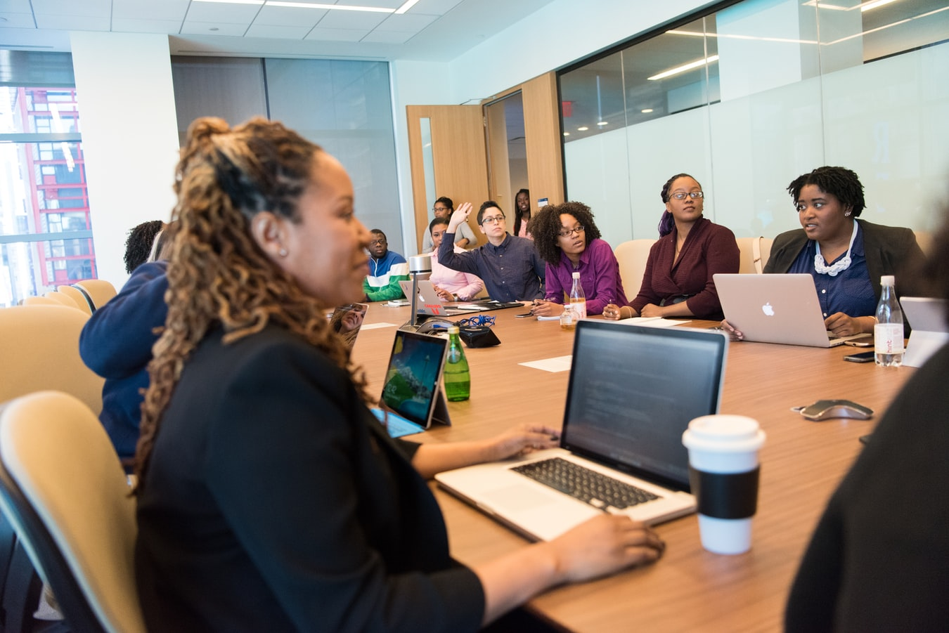
Next Steps: FRC, Provost, & President Recommendations
All decisions go to the FRC, then Provost, then President
If you have a PRC member who is serving on the FRC, they will be recused from the discussion and vote at FRC level
A program member (who was not on your PRC) is allowed to discuss and vote at the FRC level
After the FRC vote and letter, the process will go the Provost and then the President
You may write a rebuttal letter after any level adds their letter (you have 3 days to submit)

Slide 17
What’s Next?
Recover (and hopefully celebrate!!)
Gap Year
Sixth Year Reconsideration Review File
Must have had a positive review at one of the levels
Notify Dean of resubmission at the start of the fall semester
Submit updated file in the fall of year 6 (mid-September)
Provide new evidence or improve documentation to correct areas that were deficient

Slide 18
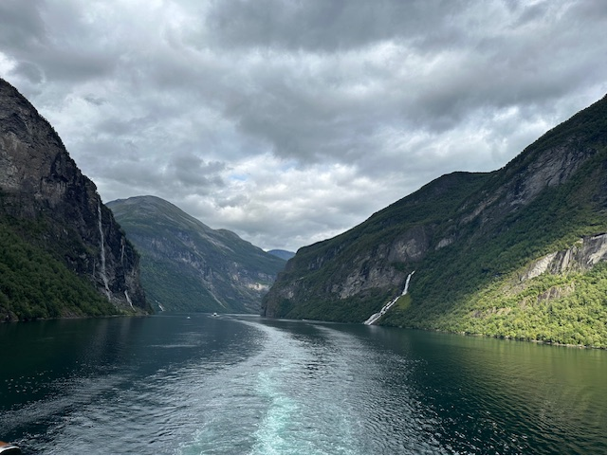
Questions??

